Slide 1
Airtra (An Airline Reservation System) By: Bishal Shrestha

Slide 2
Introduction
Airline reservation system is the computerized system.
Enhancing the relationship between customers and airline agencies.
Convenient for the customers to book the flights.
Allow the customers to access database and allow new customers to sign up for online access.

Slide 3
Goals
The primary goal of this project is to help the passengers make flight reservation.
The system will be able to find all the flights fulfilling a passengers needs.
Search all flights with a given origin and destination.
The arrival and departure time, the price and the flight number for each flight.
The passenger will decide the flight reservation based on the displayed information.

Slide 4
Major Functions
Providing flight details.
Flight booking for a particular destination
Date and time are provided with a pin code.
Allowing the customer to modify or cancel his/her reservation provided the correct pin code is given.
Displaying a report of the number of people flying in a particular flight.

Slide 5
Modules
Admin and user module
Register module
Reservation agent module
Passenger module
Payment Module(e-sewa virtual API)
Cancellation

Slide 6
Application
No geographical barriers; agents can book tickets from any location.
User-friendly graphically Interfaces helps to book tickets without knowing the specific codes of the GD Systems.
More sale of tickets brings more profits.
Less time consuming, less burden.
Online gateway and payment.
Flight Details, Packages, Details all at a same place.
Search

Slide 7
Objectives
Accuracy
Usability
Efficiency
Effectiveness
Speed
User-friendliness

Slide 8
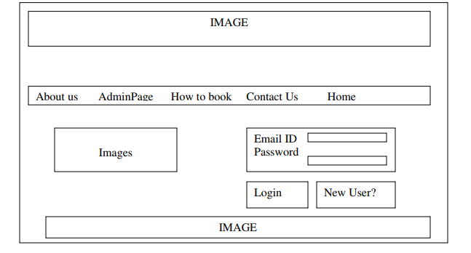
System design

Slide 9
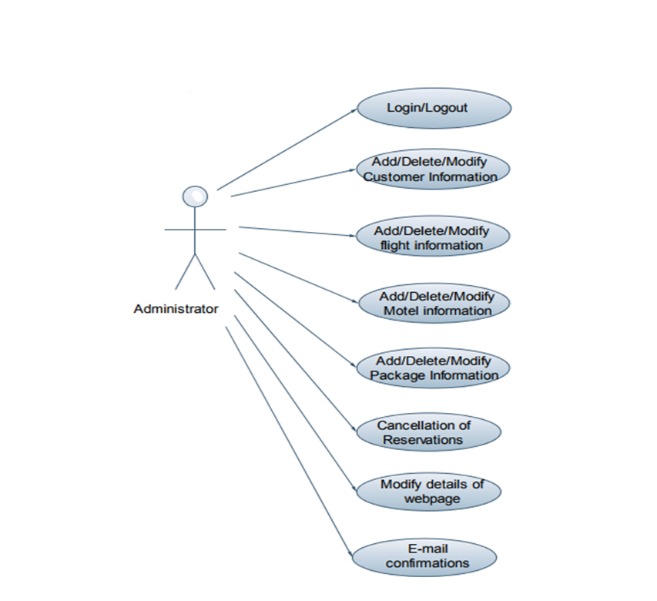
Fig. Admin Use case Diagram

Slide 10
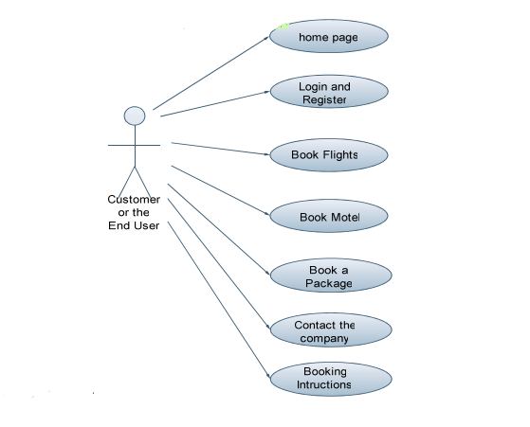
Fig. customer Use case Diagram

Slide 11
Advantages and Disadvantages
Book a flight at home. Changes and Cancellations
The freedom to shop around for a best price, cost benefits.
Many choice. Save a lot of time by a computerized GUI based system.
Flaws
Exchanging sensitive personal data, such as home addresses and payment gateways.
The online booking is an attractive target for cyber criminals looking to steal this information.

Slide 12
Conclusion
Hence,
Airline Reservation System contains the details about flights schedules, passenger reservations and ticket records.
Inventory data is imported and maintained through a Schedule Distribution System over Standardized interfaces.
In combination with the fares and booking conditions stored in the Fare Quote System the price for each sold seat is determined.
The inventory of an airline service is generally divided into three category of classes.

